Slide 1
Understanding Javascript Event-Loop
Ravikiran Yadava

Slide 2
Topics Covered in this session:
Key features of Javascript
Javascript concurrency
Asynchronous Javascript
Event Loop

Slide 3
Key JavaScript features.
High-level Language: JavaScript is a high-level programming language, which means it provides abstractions that allow you to focus on solving problems rather than worrying about low-level details like memory management.
Interpreted Language: JavaScript is an interpreted language, meaning that the code is executed line-by-line by an interpreter (e.g., web browser or Node.js runtime) without the need for compilation. This enables rapid development and testing cycles.
Dynamic Typing: JavaScript is dynamically typed, allowing variables to hold values of any data type. This flexibility simplifies coding but requires careful handling to avoid unexpected behaviors.
Prototypal Inheritance: JavaScript uses prototypal inheritance, where objects can inherit properties and methods from other objects (prototypes). This prototype-based inheritance model is different from classical inheritance found in languages like Java or C++.
First-class Functions: Functions in JavaScript are first-class citizens, meaning they can be assigned to variables, passed as arguments to other functions, and returned from functions. This enables powerful functional programming paradigms.
Event-Driven Programming: JavaScript is commonly used for event-driven programming, where actions or events trigger the execution of certain functions. This is especially prevalent in web development for handling user interactions and asynchronous operations.
Asynchronous Programming: JavaScript supports asynchronous programming, allowing tasks to be executed concurrently without blocking the main execution thread. This is crucial for handling I/O operations, such as fetching data from servers or interacting with databases.
DOM Manipulation: In web development, JavaScript interacts with the Document Object Model (DOM) to dynamically update the content, structure, and style of web pages in response to user actions or other events. This enables the creation of interactive and dynamic web applications.
Cross-platform Compatibility: JavaScript is supported by all modern web browsers, making it a cross-platform language for web development. Additionally, JavaScript can be used outside the browser with platforms like Node.js, enabling server-side and desktop application development.
Rich Ecosystem: JavaScript has a vast ecosystem of libraries, frameworks, and tools that facilitate various development tasks. Popular libraries and frameworks like React, Angular, and Vue.js simplify front-end development, while Node.js provides a robust platform for server-side development.
JavaScript's single-threaded nature and how it impacts concurrency.
JavaScript is a single-threaded language, meaning it has only one call stack and one memory heap. This single-threaded nature has significant implications for concurrency, particularly in the context of web development and other environments where JavaScript is commonly used.
Event Loop: JavaScript utilizes an event loop to handle asynchronous operations. This mechanism allows JavaScript to perform non-blocking I/O operations, such as fetching data from a server or waiting for a timer to expire, without halting the execution of the main thread. When an asynchronous operation completes, a corresponding event is placed in the event queue.
Concurrency via Callbacks, Promises, and Async/Await: JavaScript provides several mechanisms for managing asynchronous code execution, such as callbacks, promises, and async/await syntax. These mechanisms allow developers to write code that appears synchronous while leveraging asynchronous operations. Under the hood, these constructs utilize the event loop to manage concurrency effectively.
Avoiding Blocking Operations: Because JavaScript is single-threaded, blocking operations (e.g., heavy computations or long-running tasks) can cause the entire application to freeze or become unresponsive. To mitigate this issue, developers should delegate such operations to separate threads using Web Workers or other techniques, allowing the main thread to remain responsive.
Shared Memory Model: In environments like Node.js, where JavaScript is used for server-side development, concurrency can be managed through a shared-memory model. While JavaScript itself remains single-threaded, Node.js leverages the underlying operating system's threading capabilities to handle concurrent I/O operations efficiently.
Concurrency Limitations: Despite its asynchronous capabilities, JavaScript's single-threaded nature imposes limitations on concurrency. For CPU-bound tasks that require intensive computation, JavaScript may not be the most suitable choice, as it cannot fully utilize multi-core processors without additional concurrency management techniques.
In summary, JavaScript's single-threaded nature influences how concurrency is managed in web development and other environments. Developers must leverage asynchronous programming techniques, avoid blocking operations, and consider alternative approaches for CPU-bound tasks to ensure efficient and responsive applications.

Slide 4
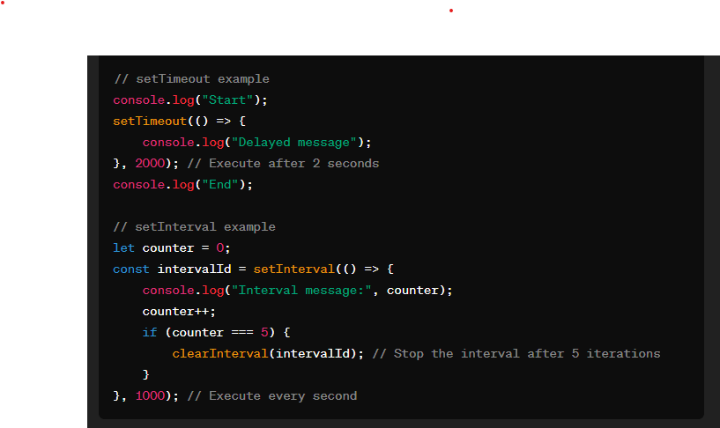
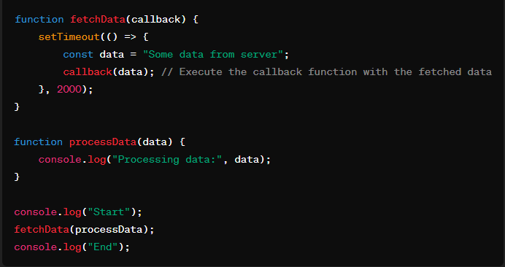
Asynchronous Javascript: Asynchronous JavaScript allows code to execute independently from the main program flow, enabling non-blocking behavior. This means that certain operations can be performed in the background while the rest of the code continues to execute. Below, I'll explain the three points you mentioned with examples:
setTimeout and setInterval
setTimeout and setInterval are functions used to execute code asynchronously after a specified delay.
setTimeout: executes a function or evaluates an expression once after a specified delay (in milliseconds).
setInterval: repeatedly executes a function or evaluates an expression at specified intervals (also in milliseconds)
Callback functions
Callback functions are functions that are passed as arguments to other functions and are executed later, often after some asynchronous operation completes.
They allow us to continue with other tasks while waiting for an operation to finish.

Slide 5
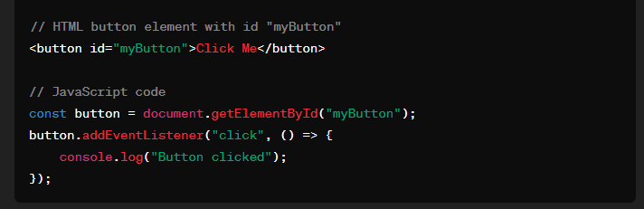
Asynchronous Javascript: Event listeners:
Event listeners are functions that wait for a specific event to occur and then execute a callback function.
They are commonly used in web development to handle user interactions or respond to changes in the environment (like page load, clicks, keypress, etc.).
These examples demonstrate how async JS operates using setTimeout, setIntervals,callback functions and eventlisteners
to handle operations that don’t need to block the main execution flow.

Slide 6
Event Loop
In JavaScript, the event loop is a fundamental concept for managing asynchronous tasks and ensuring that the single-threaded nature of JavaScript does not result in blocking operations. Understanding the event loop is crucial for writing efficient and non-blocking code.
Here's an overview of how the event loop works in JavaScript:
1. **Single-threaded nature**: JavaScript is single-threaded, meaning it can only execute one piece of code at a time. This differs from multi-threaded environments where multiple threads can execute code simultaneously.
2. **Asynchronous tasks**: JavaScript can perform asynchronous tasks such as making HTTP requests, reading files, or waiting for user input without blocking the main thread. These tasks are handled by the browser or the runtime environment (like Node.js) asynchronously.
3. **Event-driven architecture**: JavaScript follows an event-driven architecture, where certain actions or events trigger the execution of associated code. Examples of events include user interactions (like clicks and keystrokes), timers (setTimeout, setInterval), and I/O operations.
4. **Event loop**: The event loop is a mechanism that continuously checks if the call stack is empty. If the call stack is empty, it checks the task queue for any pending tasks. If there are tasks in the queue, the event loop will move them from the queue to the call stack for execution. This process repeats indefinitely, allowing asynchronous tasks to be processed in a non-blocking manner.
Explain the callback functions in the previous slide
Understanding the event loop and asynchronous programming is crucial for writing efficient and responsive JavaScript applications. It allows developers to perform time-consuming tasks without blocking the main thread, ensuring smooth user experiences.

Slide 7
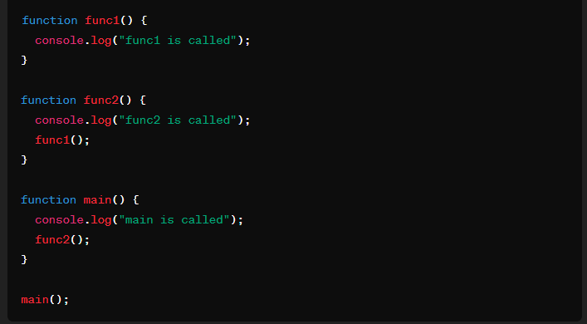
Event Loop
Call Stack and Callback Queue: how it manages function calls.
The call stack in JavaScript is a mechanism used for managing function calls. When a function is invoked (called), it is added to the call stack. If that function calls another function, that function is added on top of the previous one in the call stack, forming a stack of function calls. The call stack follows a Last In, First Out (LIFO) structure, meaning that the most recently added function is the first one to be executed and removed.
Here's a simplified view of how the event loop works:
Check the call stack. If it's empty, proceed to the next step.
Check the event queue. If there are events/callbacks present,
take the first one and push it onto the call stack.
Execute the event/callback on the call stack.
Repeat steps 1-3.

Slide 8
Event Loop
Web APIs: How browser APIs like DOM, AJAX, and setTimeout interface with the JavaScript runtime.
Browser APIs such as the Document Object Model (DOM), XMLHttpRequest (XHR) or fetch for AJAX requests, and setTimeout are essential for web development, and they interface with the JavaScript runtime in different ways:
1. **Document Object Model (DOM)**:
- The DOM is a programming interface for web documents. It represents the structure of HTML and XML documents and provides a way to interact with and manipulate them.
- JavaScript code interacts with the DOM through a set of objects and methods provided by the browser.
- When the browser parses an HTML document, it creates a DOM tree, where each element in the HTML becomes a node in the tree. JavaScript code can then access and manipulate these nodes using DOM methods and properties.
- When JavaScript code interacts with the DOM, the browser handles the actual manipulation of the document structure and content based on the instructions provided by the script.
2. **AJAX (Asynchronous JavaScript and XML)**:
- AJAX allows JavaScript code to make asynchronous HTTP requests to the server without reloading the entire web page.
- In traditional synchronous JavaScript, making an HTTP request would block the execution of the script until the response is received, causing the page to freeze. AJAX allows requests to be made asynchronously, so the script can continue to run while waiting for the response.
- JavaScript code initiates an AJAX request by creating an XMLHttpRequest object (or using the newer fetch API), configuring it with the desired parameters (such as the URL and request method), and defining event handlers to handle the response asynchronously.
- When the request is sent, the browser handles the actual sending of the request and processing of the response. When the response is received, the browser triggers the appropriate event handlers defined by the JavaScript code.
3. **setTimeout and setInterval**:
- setTimeout and setInterval are functions provided by the browser's JavaScript runtime environment for scheduling the execution of code at a later time.
- JavaScript code calls setTimeout or setInterval with a function to execute and a specified delay or interval, respectively.
- When setTimeout or setInterval is called, the browser schedules the specified function to be executed after the specified delay or at regular intervals, respectively. The browser manages the timing and execution of these scheduled tasks independently of the main JavaScript execution thread.
- When the scheduled time arrives, the browser adds the specified function to the execution queue, where it will be executed when the JavaScript engine is free to process it.
In summary, browser APIs like the DOM, AJAX, and setTimeout interface with the JavaScript runtime by providing mechanisms for interacting with the browser environment (such as manipulating the document, making HTTP requests, and scheduling code execution) while abstracting away the details of how these interactions are implemented internally by the browser.

Slide 9
Event Loop
Microtasks and Macrotasks: Difference between microtasks (e.g., Promises) and macrotasks (e.g., setTimeout) and how they're prioritized in the event loop.
In JavaScript, the event loop is responsible for managing the execution of code, handling asynchronous operations, and ensuring that the application remains responsive. Understanding microtasks and macrotasks is crucial for understanding how asynchronous operations are handled in JavaScript.
**Microtasks**:
Microtasks are tasks that are executed asynchronously but are part of the same task. They are typically created by promises and certain APIs like `queueMicrotask()` or `MutationObserver`. Microtasks are executed after the currently executing script (macro-task) completes but before any rendering or input event is handled.
Examples of microtasks:
- Promises (resolved or rejected handlers)
- `queueMicrotask()` calls
- MutationObserver callbacks
**Macrotasks**:
Macrotasks, on the other hand, are tasks that are queued in the event loop and executed independently of the currently executing script. They are usually associated with I/O operations or timer events.
Examples of macrotasks:
- `setTimeout` and `setInterval` callbacks
- I/O operations (e.g., reading a file)
- User input events (e.g., click events)
**Difference**:
The main difference between microtasks and macrotasks lies in their execution timing and priority in the event loop. Microtasks are executed before macrotasks. Microtasks are typically used for operations that need to be executed as soon as possible after the current script finishes, such as updating the UI based on asynchronous data retrieval. Macrotasks, on the other hand, are often used for tasks that can be deferred and executed later, such as executing code after a certain delay or handling user input.
**Prioritization in the event loop**:
In the event loop, microtasks have a higher priority than macrotasks. When the current execution context finishes (e.g., a function completes), the event loop checks for any microtasks that need to be executed. It processes all available microtasks before moving on to the next macrotask. This ensures that microtasks are executed as soon as possible, providing a smoother user experience and allowing for more responsive applications.
In summary, microtasks and macrotasks are both essential for handling asynchronous operations in JavaScript. Microtasks are executed before macrotasks, and they have a higher priority in the event loop. Understanding their differences and how they're prioritized in the event loop is crucial for writing efficient and responsive JavaScript code.

Slide 10
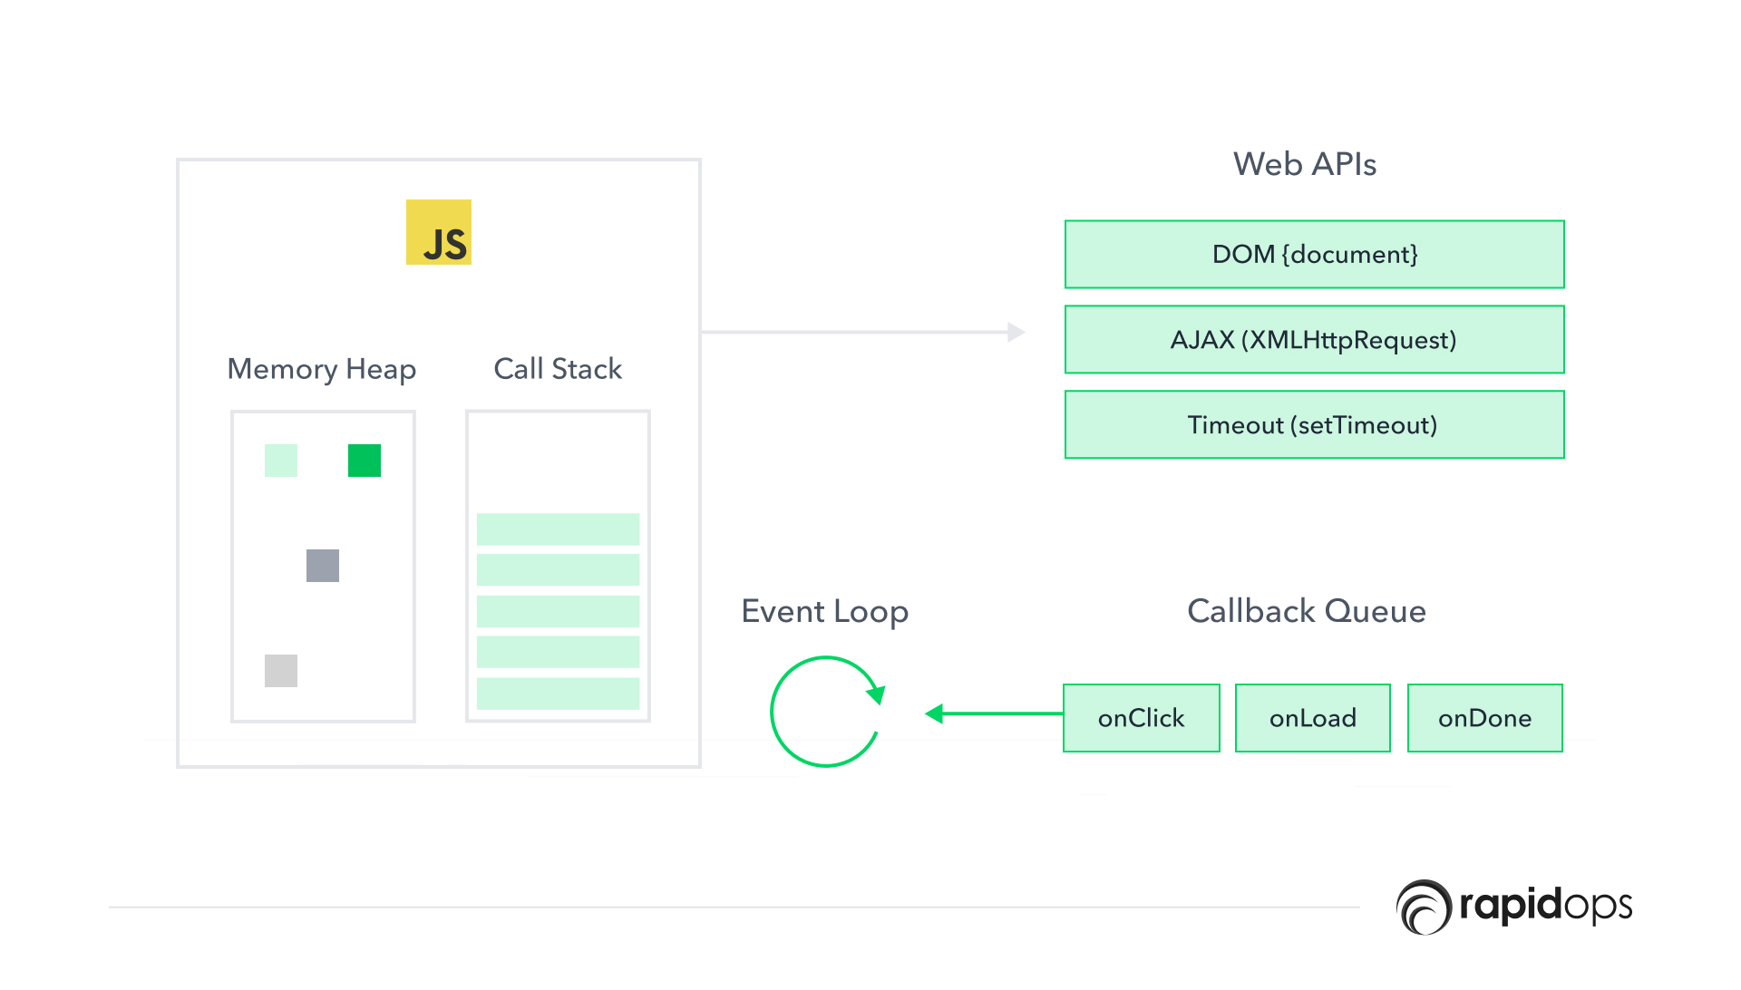
Event Loop
Fig 1: Javascript Event Loop
Ref: https://www.rapidops.com/blog/event-loop-with-javascript/

Slide 11
Best Practices and Pitfalls
Best Practices: Discuss best practices for writing efficient asynchronous JavaScript code.
Common Pitfalls: Highlight common mistakes and pitfalls developers may encounter when dealing with the event loop.

Slide 12
Questions and Answers

Slide 13
Thank You

